Slide 1
Design and Implementation of an Occupational
Internal Dosimetry Program
Presented a the NCCHPS Fall Meeting
October 6, 2011
Charles “Gus” Potter, Ph.D., C.H.P.
Distinguished Member of Technical Staff

Slide 2
Topics
Derivation of intake retention fractions
Design and implementation of an operational bioassay program
Management of bioassay data (now what do I do?)

Slide 3
Introduction

Slide 4
What is internal dosimetry good for?
To provide timely feedback
on workplace control.

Slide 5
What is internal dosimetry good for?
To initiate medical
intervention.

Slide 6
What is internal dosimetry good for?
To show compliance with
a standard or regulation.

Slide 7
Definition – Internal Dose
The energy deposition, exposure, or risk obtained from radioactive material taken internally. While there are no limits to internal dose specifically, there are limits to total (i.e., external plus internal) dose.

Slide 8
Definition – Dosimetry
The measurement or inference by calculation of dose.

Slide 9
Definition – Internal Dosimetry
The sub-field of health physics that includes design and implementation of programs, calculation of dose, development of metabolic models, derivation of absorbed fractions and specific effective energies, etc..

Slide 10
Definition – Radiobioassay, Bioassay
Sampling of individuals through direct (in vivo) counting or indirect (in vitro) sampling and associated analysis.

Slide 11
Derivation of Intake Retention Fractions

Slide 12
Icrp biokinetic models
Derivation of Intake Retention Fractions

Slide 13
ICRP Publication 68 Framework
Dose Coefficients for Intakes of Radionuclides by Workers
Current comprehensive system of dose coefficients and models available for use

Slide 14
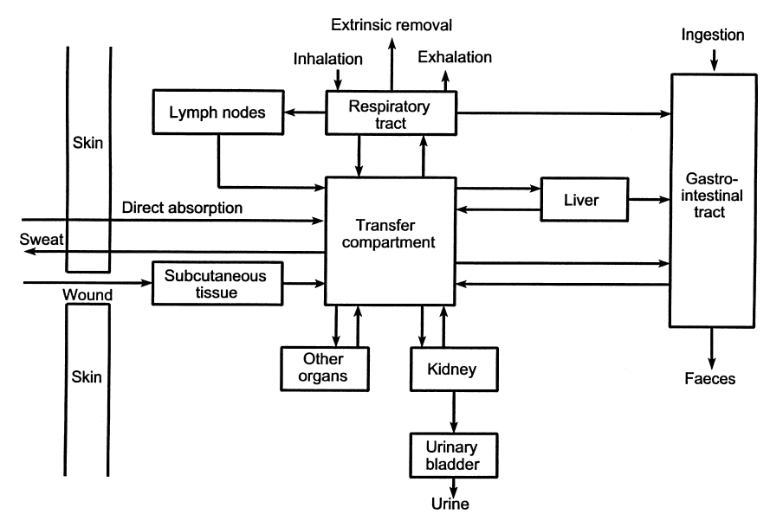
The Human Body

Slide 15
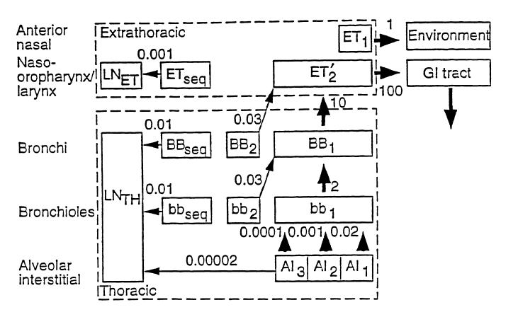
ICRP Publication 66 Respiratory Tract Model
Notes:
Clearance Model

Slide 16
Regional Percent Deposition
Region | 1 μm | 5 μm
ET₁ | 16.52 | 33.85
ET₂ | 21.12 | 39.91
BB | 1.24 | 1.78
bb | 1.65 | 1.10
AI | 10.66 | 5.32
Total | 51.19 (34.67) | 81.96 (48.11)
Notes:
Deposition driven by particle size. Default is now 5 um as opposed to ICRP-30 1 um particle size.
Total deposition is: 0.8196, old ICRP-30 1 um deposition was 0.63
Regional:
ET: 0.7376 (compare 0.3)
BB: 0.0178
bb: 0.011 (total 0.0288, compare 0.08)
AI: 0.0532 (compare 0.25)
Parentheses are totals w/o ET1 i.e, available for absorption

Slide 17
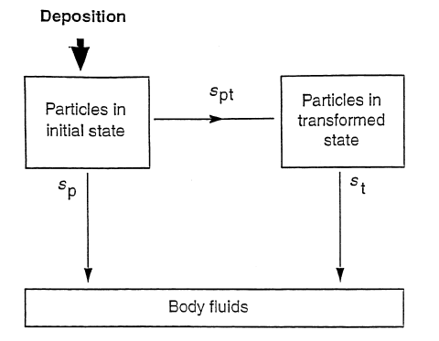
Absorption Model
Notes:
Absorption pathways only shown here. They compete with mechanical clearance shown on the previous slide. For those more familiar with the ICRP-30 model, absorption and clearance were represented by separate compartments in which material was deposited.
Draw in bound state. Bound state is not cleared by mechanical transport processes – only absorbed into bloodstream.

Slide 18
Absorption Model Parameters
Type | F (fast) | M (moderate) | S (slow)
s_{p} | 100 | 10 | 0.1
s_{pt} | 0 | 90 | 100
s_{t} | -- | 0.005 | 0.0001
Notes:
Note: Class F has no transformed state compartment

Slide 19
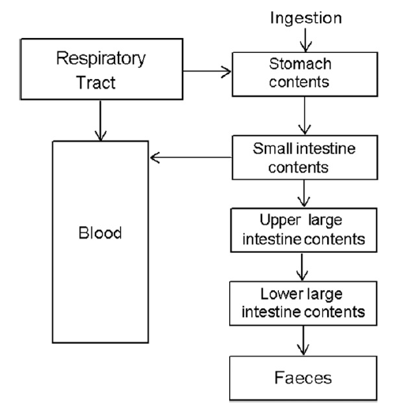
Gastrointestinal Tract

Slide 20
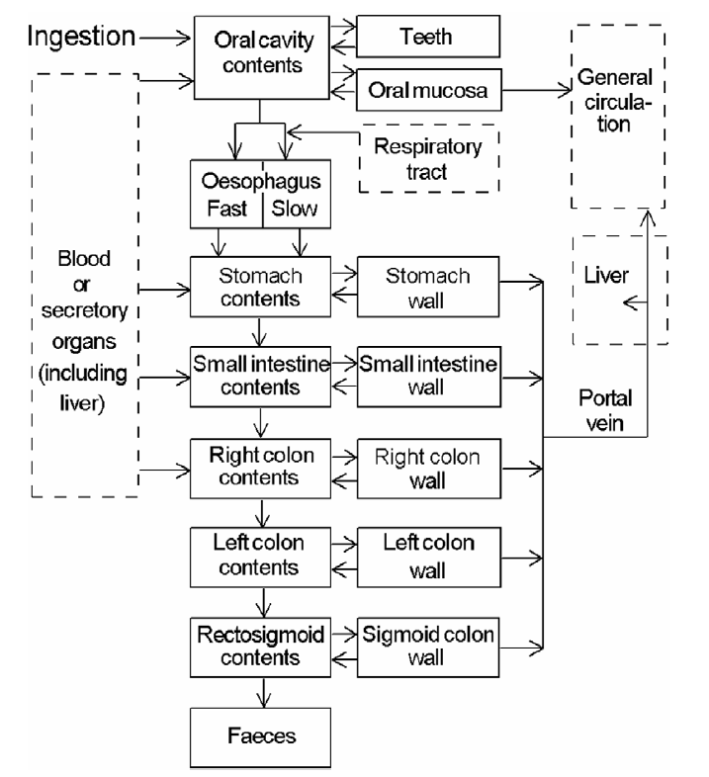
(ICRP 100 GI Tract Model)

Slide 21
ICRP Publications Containing Systemic Models
ICRP Publication | Elements
56 | H, Nb, I
67 | Zn, Sr, Zr, Mo, Ag, Te, Ba, Ce, Pb, Po, Ra, Np, Pu, Am
69 | Fe, Se, Sb, Th, U
71 | Cm
30 (all parts) | All other elements (up to Md)
Notes:
ICRP-68 Table 5
Just because it’s in this table doesn’t mean that model is complicated. Many such as Zn, Se, Nb have just had rate constants changed from ICRP-30 models.
I has always been recycling model, but excretion pathways are clarified – blood to urine, ROB to feces. Rate constants are the same as stated in the ICRP-30 part 3 errata – 80 days for thyroid vs. 120 days in part 1.
Those with new models:
H (new compartment added)
Alkaline earth (no Ca), Pb, U
Th, Np, Pu, Am, Cu
Fe

Slide 22
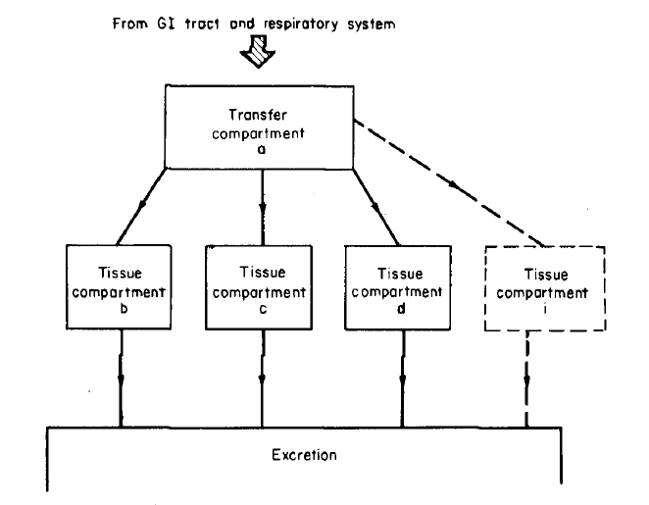
Basic ICRP Publication 30 Model

Slide 23
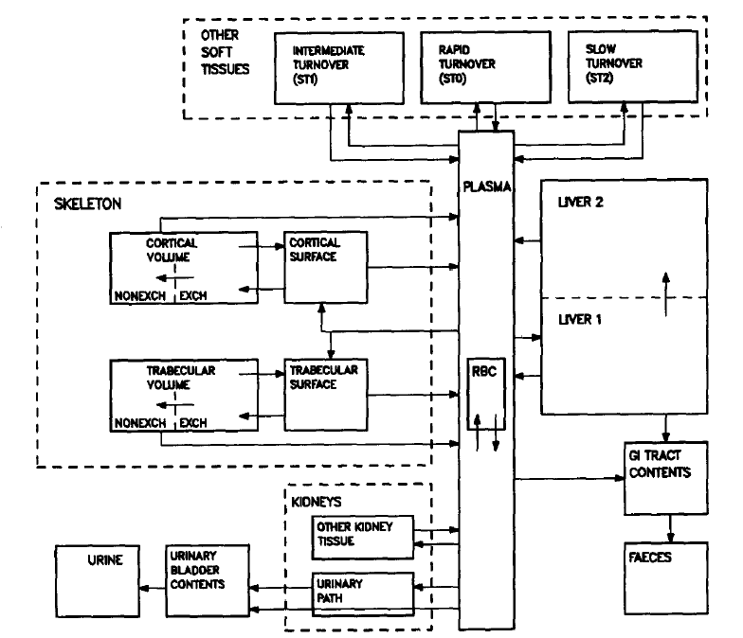
Generic Bone Volume Model
Notes:
Models are going in this direction. This is alkaline earth elements, Pb, uranium.
Th, Np, Pu, Am same except for different skeleton compartments.
New Fe model similar in structure but blood-forming organs called out.

Slide 24
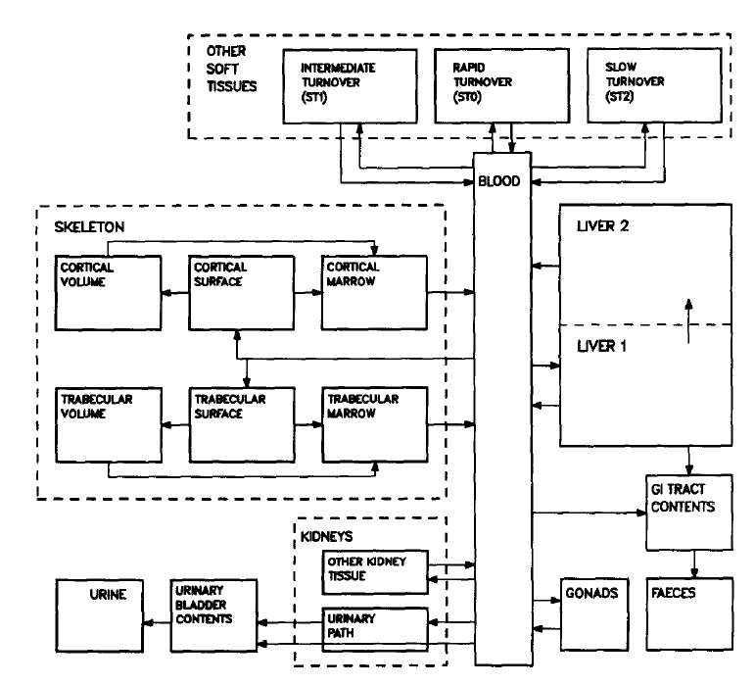
Generic Bone Surface Model

Slide 25
Urine/Fecal Excretion Ratios
Previously specified in only a few cases (ICRP-10A).
Assumed to be 1/1 unless stated otherwise.
Explicitly defined in some models.
Notes:
a: Ge – urine in kidney all to urine excretion, ratio of 1 for other tissues
b: Au – all excretion assumed to urine
Other elements where excretion is explicitly defined in model include:
Alkaline earth (no Ca), Pb, U
Th, Np, Pu, Am, Cu
Fe

Slide 26
Mathematics of intake retention fractions
Derivation of Intake Retention Fractions

Slide 27
Example Catenary System
Notes:
Common system for acute intake. Initial # atoms N₁(0) in first compartment at time t=0.
System can be of any number of compartments. Compartments commonly represent specific organs and tissues.
In this example, recycling occurs, i.e., material moves back and forth between compartments as opposed to straight through. This type of system is becoming more prevalent as models are upgraded.
We will use the notation presented here throughout the examples. Double arrayed variables, i.e., k_{1,2}, k_{2,1} are rate constants for the specific pathway shown in the subscript. For example, k_{1,2} is the rate constant describing translocation between compartment 1 and compartment 2.
Total removal from a compartment is represented by a single subscripted rate constant, e.g., k₁, and may or may not include radioactive decay, depending on how we define the system.

Slide 28
Differential Equations
Notes:
The basic assumption in biokinetic modeling is that the rate of change of amount in biological compartment is proportional to the amount in the compartment. We can set up differential equations for each compartment based on rates in and out of the compartment.
Point out terms including:
Partial rate constants show material moving into a compartment and where from.
Total removal rate constants are negative because that is material removed from the compartment.

Slide 29
Matrix Equations
Notes:
Previous equations can be represented in matrix form. In matrix multiplication we multiply row by column.
Point out indices in k matrix – indices are reversed from normal matrix notation. If we assign a value to k_{2,1} and expect Mathematica to put it as the second item in the first row, it won’t happen.
To counter this problem, we operate on the transpose of the matrix.

Slide 30
Eigenvalues and Eigenvectors
Notes:
Eigenvalues: list of constants, γ, that solve the determinant. “I” is t he identity matrix. (more next slide).
Eigenvectors: list of matrices v that solve this equation. These are column matrices, one for each eigenvalue (more later)

Slide 31
Final Equations
Notes:
Once we obtain the eigenvalues and eigenvectors, the set of equations N are obtained in this manner. Note that on the slide provided a pi product was incorrectly included where a summation should have occurred.

Slide 32
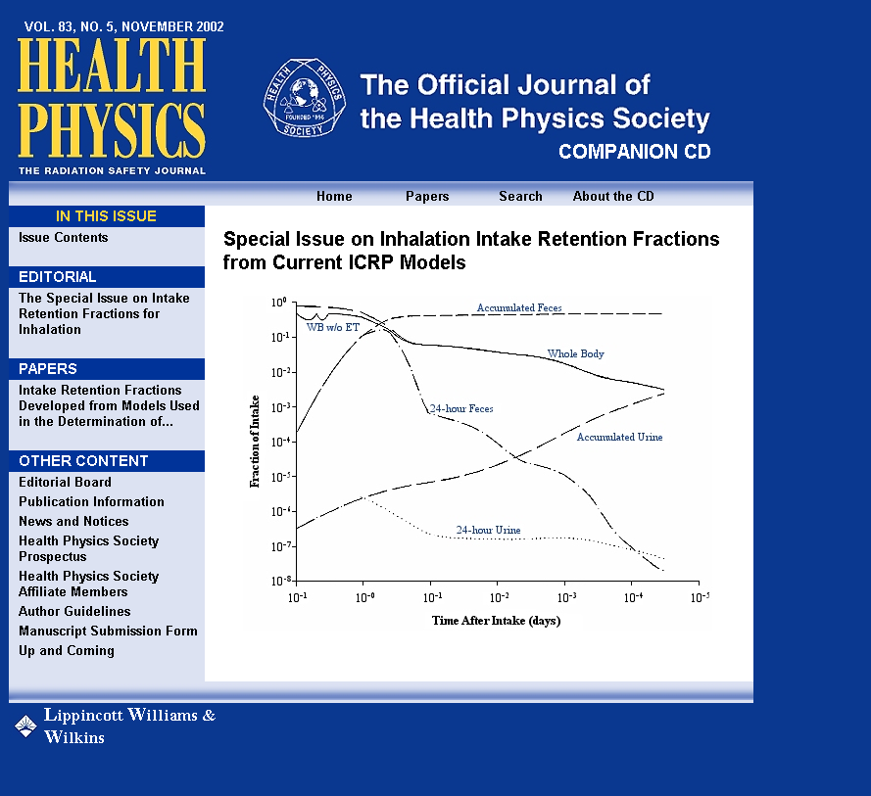
Intake Retention Fractions
Notes:
What’s included:
Inhalation pathway, particulates only.
Not included: ingestion pathway, gases
Errata: Equation 21 – should have inverse
Curium – table in article correct, but not in separate appendices

Slide 33
Bioassay Program Design

Slide 34
Requirements and recommendations
Bioassay Program Design

Slide 35
Recommendations vs. Requirements
Recommendations:
  International Commission on Radiological Protection “Publications”
  National Council on Radiation Protection and Measurements “Reports”
  Health Physics Society ANSI Standards (N13)
Notes:
N43 is on safety of industrial and nonmedical radiation-producing devices.

Slide 36
Recommendations vs. Requirements
Requirements:
  Nuclear Regulatory Commission
    Code – 10CFR20
      (Regulatory Guides)
      (NUREG reports)
  Department of Energy
    Code – 10CFR835
      (Technical Standards)
      (Technical Positions)
      (Implementation Guide)

Slide 37
ICRP Publications – Models
Operational use dose coefficients: ICRP Publication 68
Respiratory tract – ICRP Publication 66
Alimentary tract – ICRP Publication 100
Metabolic models and dose coefficients – ICRP Publications 56, 67, 69, 71, 72
Anatomical and physiological data – ICRP Publication 89

Slide 38
ICRP Publications – Protection
Individual monitoring – ICRP Publication 78
Radiation protection principles – ICRP Publication 75
General recommendations – ICRP Publication 103
Nuclear decay data – ICRP Publication 107

Slide 39
NCRP Publications
Management of contaminated persons –
NCRP Report No. 161
Biokinetic wound model – NCRP Report No. 156
Operational radiation protection –
NCRP Report No. 127
Inhaled radioactive substances –
NCRP Report No. 125
Bioassay procedures – NCRP Report No. 87
Internal dosimetry concepts –
NCRP Report No. 84
Notes:
84 – anti committed dose

Slide 40
HPS N13 Standards
Design of internal dosimetry programs – N13.39
Radiobioassay performance – N13.30
BOMAB specifications – N13.35
Radionuclide-specific standards:
  Tritium – N13.14
  Uranium – N13.22
  Fission/Activation products – N13.42
  Plutonium – (N13.25)

Slide 41
Dose Limits
ICRP Recommendations
  0.05 Sv/year
  0.1 Sv/5 years
  Limits stochastic and deterministic effects
NRC/DOE Requirements
  5 rem/year – stochastic effects
  50 rem/year – deterministic effects
Monitoring requirements discussed in next part

Slide 42
Program Elements
Bioassay Program Design

Slide 43
Management
Management
  establishes and funds the safety programs, which include the Internal Dosimetry Group and RadCon Group
  establishes and enforces fundamental safety policies
    workers can raise safety concerns without fear of retaliation
    each worker is responsible for his own safety
Because safety programs are typically not revenue centers, establishing an adequate, balanced safety program is no mean task

Slide 44
Workers
The workers are our primary customer and we must always remember that
As internal dosimetrists we sometimes underestimate how important what we do can be to some individuals
Good communication skills are essential for keeping workers informed and building trust
  Once trust is lost it is not easily regained

Slide 45
RadCon
The radiological control (RadCon) group is responsible for implementing radiation safety programs in the workplace
  job planning and coverage
  workplace surveys
  workplace air monitoring
  incident response and recovery
RadCon are our eyes, ears, and feet
We can tell a worker the dose he got from an intake – RadCon can prevent the intake

Slide 46
Bioassay Lab
There are commercial and government radiobioassay laboratories
  USDOE facilities may have their own dedicated laboratory
  government labs are not permitted to compete with commercial laboratories on non-government work
  specialized analyses like TIMS for Pu in urine and Pu/Am chest counting are not available commercially
We are the customer of the lab and we should make every effort to tell them what we need and check to see if we are getting it

Slide 47
Internal Dosimetrist
Designs programs to monitor workers for intakes of radioactive materials
Interprets the monitoring data to determine if the operation is in compliance with regulatory limits
Communicates these interpretations to all interested stakeholders

Slide 48
Qualifications for
Internal Dosimetrists
In the US
  There are no minimal qualifications, training, experience, or education specified for an internal dosimetrist at the professional (HPS) or regulatory (USDOE, USNRC) level
  There are no accreditation programs for the internal dose assessment process
Canada is in the beginning stages of implementing a “certification program” for dosimetry services
  Regulatory Standard S-106 Revision 1, Technical and Quality Assurance Requirements for Dosimetry Services, May 2006
  Internal Dosimetrist == Internal Dosimetry Services
In the end, the burden of certifying that an individual is qualified to perform occupational internal dose calculations usually rests with the management of the organization

Slide 49
Guidance
ISO/IEC 17025:2005 General requirements for the competence of testing and calibration laboratories
  Intended for testing and calibration laboratories, but if you consider the determination of dose as part of the analysis, it applies to what we do
ANSI/HPS N13.39-2001 Design of Internal Dosimetry Programs
  Provides suggested training and education for internal dosimetrists
Notes:
• advanced mathematical methods, such as
calculus, differential equations, and statistical
analyses;
• radiochemistry and radiometric methodology
and concepts;
• computer technology applicable to dose
assessment;
• anatomy and physiology of the human body
and effects of ionizing radiation on biological
systems;
nuclear radiation physics;
• principles of internal dosimetry including
national and international guidance;
• communication of risk to workers;
• operational health physics;
• technical writing.

Slide 50
Requirements/Recommendations for Program
ICRP
  the handling of large quantities of gaseous and volatile materials, e.g. tritium and its compounds in large scale production processes, in heavy water reactors and in luminising,
  the processing of plutonium and other transuranic elements,
  the processing of thorium ores and use of thorium and its compounds (these activities can lead to internal exposure from both radioactive dusts and thoron and its progeny),

Slide 51
Requirements/Recommendations for Program
ICRP (cont.)
  the milling and refining of high grade uranium ores,
  natural and slightly enriched uranium processing and reactor fuel fabrication,
  the production of large quantities of radionuclides,
  workplaces where radon levels exceed the action level, and
  the handling of large quantities of iodine-131, e.g. for therapy.

Slide 52
Requirements/Recommendations for Program
NRC
“Each licensee shall monitor (see §20.1204) the occupational intake of radioactive material by and assess the committed effective dose equivalent to (1) Adults likely to receive, in 1 year, an intake in excess of 10 percent of the applicable ALI(s) in table 1, columns 1 and 2, of appendix B to §§20.1001–20.2402”
Notes:
20.1502(b)

Slide 53
NRC Regulatory Guides
Reg Guide 8.11 Applications of Bioassay for Uranium (June, 1974): “a bioassay program is necessary if air sampling is necessary for the purposes of personnel protection.”
Reg Guide 8.22 Bioassay at Uranium Mills (August, 1988): “Routine bioassays are considered by the NRC staff to be necessary for workers (1) routinely exposed to airborne yellowcake or directly involved in maintenance tasks in which yellowcake dust may be produced or (2) routinely exposed to airborne uranium ore dust.”

Slide 54
NRC Regulatory Guides
Reg Guide 8.20 Applications of Bioassay for I-125 and I-131 (September, 1979: “Routine bioassay is necessary when an individual handles in open form unsealed quantities of radioactive iodine that exceed those shown in Table 1 of this guide.”
Reg Guide 8.32 (July 1988) Critera for Establishing a Tritium Bioassay Program: “Routine bioassay is necessary when quantities of tritium processed by an individual at any one time or the total amounts processed per month exceed those shown in Table 1 for each form of tritium.
Notes:
Table 1 contains amounts depending on chemical form and type of process for both guides.

Slide 55
NRC Reg Guides
Reg Guide 8.26 (September 1980) Applications of Bioassay for Fission and Activation Products amends paragraph 6.2.2 of ANSI N343-1978 in stating, “All facility personnel who routinely enter bioassay areas for routine operations or for maintenance work are to be scheduled for in vivo measurements in accordance with the minimum bioassay program.”

Slide 56
Requirements/Recommendations for Program
DOE
“For the purpose of monitoring individual exposures to internal radiation, internal dosimetry programs (including routine bioassay programs) shall be conducted for:
(1) Radiological workers who, under typical conditions, are likely to receive a committed
effective dose of 0.1 rem (0.001 Sv) or more from all occupational radionuclide intakes in a
year…”
Notes:
835.402(c)

Slide 57
Requirements/Recommendations for Program
DOE
d) Internal dose monitoring programs implemented to demonstrate compliance with §835.402(c) shall be adequate to demonstrate compliance with the dose limits established in subpart C of this part and shall be:
(1) Accredited, or excepted from accreditation, in accordance with the DOE Laboratory Accreditation Program for Radiobioassay;…
Notes:
835.402(c)

Slide 58
DOE RadCon Standard
DOE-STD-1098-2008 Radiological Control Part 2 Section 521 (4): “Individuals whose routine duties may involve exposure to surface or airborne contamination or to radionuclides readily absorbed through the skin, such as tritium, should be considered for participation in the bioassay program.

Slide 59
Bioassay monitoring program types
Bioassay Program Design

Slide 60
Types of Bioassay Programs
There are a number of different types of bioassay programs that can go by a variety of names
  Routine
  Confirmatory
  Special
  Baseline/Termination
  Operational
Notes:
Tom’s original said confirmatory and routine were the same. Talk about the difference yere.

Slide 61
Confirmatory Bioassay
Performed at prescribed times that are not directly related to work activities
Collected from workers exposed to “known” levels of radioactive material
  where “known” could be zero
Shows that engineered and procedural controls have been effective in preventing or controlling intakes
Final QC check of radiological protection program

Slide 62
Routine Bioassay
Same as confirmatory but meets the requirements for routine monitoring.
Usually administered at periodic frequencies.
Follows chronic intakes.
Unusual during current times due to minimization of contamination in the workplace.

Slide 63
Special Bioassay
Collected from workers potentially exposed to unexpected or unknown levels of radioactive material that could result in a CED in excess of the monitoring level or other investigation levels
Used to confirm and evaluate intakes of radioactive material by workers and determine compliance with regulations

Slide 64
Special Bioassay Required
Facial or nasal contamination
Potential exposure to airborne radioactivity without respiratory protection
Damage to or failure of a respirator
Protection factor of respirator exceeded
Significant skin contamination
Significant workplace contamination

Slide 65
Baseline/Termination Bioassay
Baseline bioassay
  Collected from new workers prior to beginning work with a potential for occupational exposure
Termination bioassay
  Collected from workers when they terminate participation in a routine bioassay program
Both are used to establish the radiological status of the worker when starting or stopping participation in a bioassay program

Slide 66
Baseline Bioassay Advice
If a worker has never worked in a radiological facility, then don’t bother performing a baseline bioassay
If a worker has been on a bioassay program before, then perform a baseline bioassay for radionuclides of interest to you
If you don’t perform a baseline bioassay, then you may end up owning all subsequent positive results
If you commit a Type I or Type II error on a baseline bioassay, then you may end up owning all subsequent positive results

Slide 67
Operational Bioassay
Collected from workers after completion of specified tasks (aka job-specific bioassay)
Surrogate for confirmatory program for short term workers
Provides detailed information on exposures related to the specific job
Provides more timely detection of intakes and increases probability of detecting intakes

Slide 68
Who should be monitored?
Bioassay Program Design

Slide 69
Three different approaches
ICRP → “monitoring”
NRC → “assessing”
DOE → “conducting”
… and the dreaded “likely to receive”…

Slide 70
Potential versus Likelihood
Few workers in the US nuclear industry are truly “likely” to exceed the monitoring level as a result of routine operations
However, because of difficulties associated with determining likelihood, we tend to monitor workers who have a reasonable potential to exceed the monitoring level

Slide 71
Likelihood
The likelihood of exceeding the monitoring level will depend on
  the amount of radioactive material present and the radionuclides involved
  the physical and chemical form of the radioactive material
  the type of containment used
  the operations performed
  the general working conditions
  past operating history
  skill and training of workers
However, little guidance is offered concerning how to actually determine the likelihood of exceeding the monitoring level

Slide 72
Possible Approaches
To estimate a priori likelihood of exceeding the monitoring level use
  some sort of predictive formula involving the amount of material in process and the level of containment (ala NUREG 1400)
  available data from existing air monitoring program
  available data from existing bioassay program
We are seeking to justify our estimate of the probability (likelihood) that a person will have an intake that will deliver over the monitoring level
We are not seeking to prove that no worker will receive (or has received) an intake that will deliver over the monitoring level

Slide 73
Methodologies
ANSI/HPS N13.39 suggests a methodology (based on NUREG-1400) that helps one to estimate the amount of radioactive material in a process that should trigger a mandatory bioassay program
Area air monitoring may also be an appropriate indicator.
Notes:
Next 2 slides

Slide 74
Retrospective air monitors are representative.
  Note that in order to use this assumption in this context the monitors only need to be representative enough to make probabilistic statements about likelihood. The monitors do not have to be representative in the usual sense, which normally means that they are representative 100% of the time.
Workers entering areas >0.1 DAC (2.4 DAC-hours per 24 hour day) wear respiratory protection.
Workers wearing respiratory protection are unlikely to exceed 0.1 rem.
Workers entering areas >0.1 DAC who do not wear respiratory protection are placed on a special bioassay program (they are likely to exceed 0.1 rem).
Any excursions in air activity that exceed 2.4 DAC-hours in a day and fall under assumptions 3 or 4 are not included in the assessment of likelihood.
Occupancy time is 1000 hours per year and the air samplers run around the clock (8760 hours per year).

Slide 75
The last assumption means that the occupancy factor is 8.76, which means that a room must exceed a fairly uniform annual exposure of
(8.76)(40 DAC-hours) = 350 DAC-hours
before a worker could be considered likely to exceed 100 mrem.

Slide 76
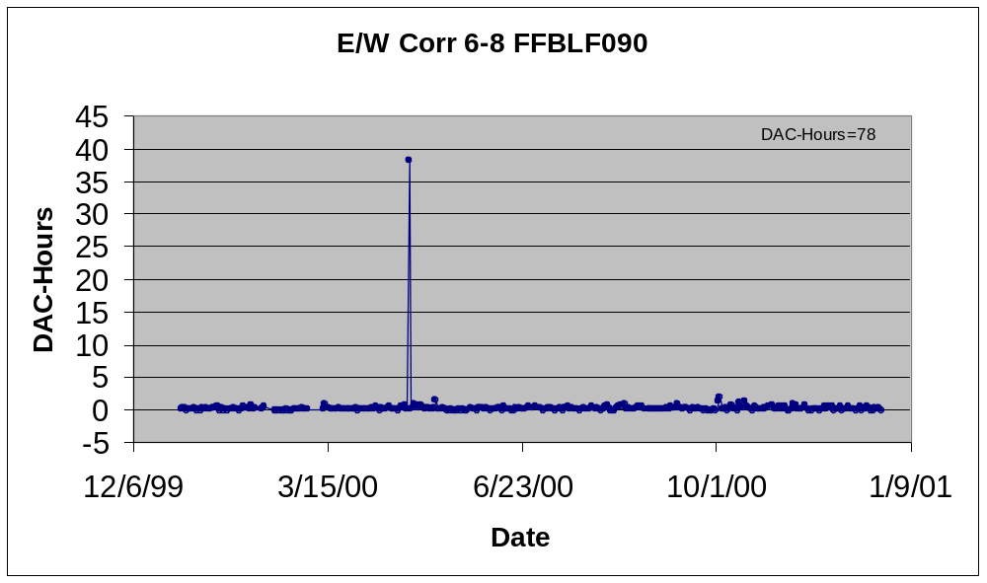
The retrospective air sampler in E/W Corridor 6-8 (FFBLF090) registered 78 DAC-hours for the year
The high result on 4/26/00 (38 DAC-hours) may be ignored in the assessment of likelihood if workers entering this area on 4/26/00 either wore appropriate respiratory protection or were placed on a special bioassay program.
Ignoring the 4/26/00 result, workers are unlikely to exceed 100 mrem in a year because the occupancy factor and the uniform exposure over the year

Slide 77
Monitor At Your Own Risk
Assume you monitor a worker who a priori you decided has no potential for an intake exceeding the monitoring level
  you go ahead and put a person on a bioassay program even though in your view he has no potential
Further, assume a bioassay result for this person turns out to be both positive and dosimetrically “unattractive”
You can not, after the fact, discount this result simply because the person “could not have had the intake” in the first place
  do not pencil-whip your mistake

Slide 78
Source Terms
Problems arise in bioassay programs where the source terms have not been adequately characterized
  the primary radionuclides have been misidentified
  dosimetrically significant contaminates have been ignored
  solubility types have not been properly determined

Slide 79
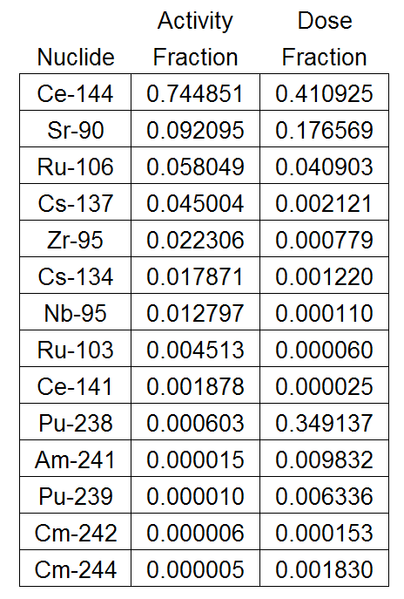
Mixed Fission Products
Workers at a USDOE site were exposed to airborne radioactive material
The material was classified as mixed fission products by operations and RadCon personnel
Only whole-body counts were prescribed
A radiochemical analysis of an air filter from the event gave the results shown here

Slide 80
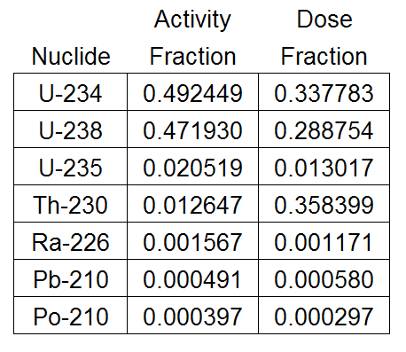
Natural Uranium
Workers at a uranium mill were exposed to natural uranium (yellowcake)
Urine bioassay for elemental uranium was prescribed
A radiochemical analysis of an air filter from routine operations gave the results shown here

Slide 81
Solubility
A worker accidently cut through a Cs-137 irradiation source, releasing airborne contamination
A whole-body count showed that the worker had inhaled some of the material, and a dose was assigned assuming Type F Cs-137 (CsCl)
A subsequent literature search showed that the source was fabricated with a relatively insoluble ceramic form of cesium, which delivers ~4x more dose per unit intake than the CsCl

Slide 82
What is the Problem?
A proper analysis of the source term is usually not easy, inexpensive, or quick to do
Data from current routine operations and generic ICRP models are applied to specific events because it is readily available
This ignores the possibility of
  legacy radionuclides
  concentration of radionuclides during processing
  impurity radionuclides that are not important to the process
  problems with data collected for a different use

Slide 83
Recommendations
Strongly consider performing a proper isotopic analysis of the contamination associated with a known exposure event
  don’t automatically assume that the material is what everyone thinks it is
  use waste stream characterization data with a modicum of caution
Don’t automatically think every material will act the way the ICRP says it will

Slide 84
MDA vs. dl
Bioassay Program Design

Slide 85
DL (CL) vs. MDA
Frequently misused and misinterpreted
Detection (critical) level
  tells us whether or not there is radioactivity in the sample itself.
Lower limit of detection (or MDA which is in terms of activity)
  describes the ability of the counting system, i.e., the activity that the system will consistently detect.
A sample-specific MDA is meaningless.
Notes:
This statistic should be reported with every sample to give the dosimetrist the ability to judge whether the sample is “positive” for the analyte in question and the data requires further analysis.

Slide 86
Empirical DL & MDA
To illustrate what the DL and MDA really are, let’s estimate the DL and MDA for Pu-239 in urine analysis without any of those messy formulas
  analyze 200 urine blanks using the normal process,
  order the results from smallest to largest
  calculate the fraction of the samples less than the i^{th} sample, where i goes from 1 to 200

Slide 87
Detection Level
A blank sample contains no analyte
As a result of random processes, we will get a range of results when we repeatedly measure the amount of analyte in a blank sample
The amount of analyte above which we would measure < α% (usually α = 5%) of the time in the blanks is referred to as the detection level (DL).
  Samples above the DL are declared to contain analyte.
  If the sample does not actually contain analyte, this error is referred to as a false positive

Slide 88
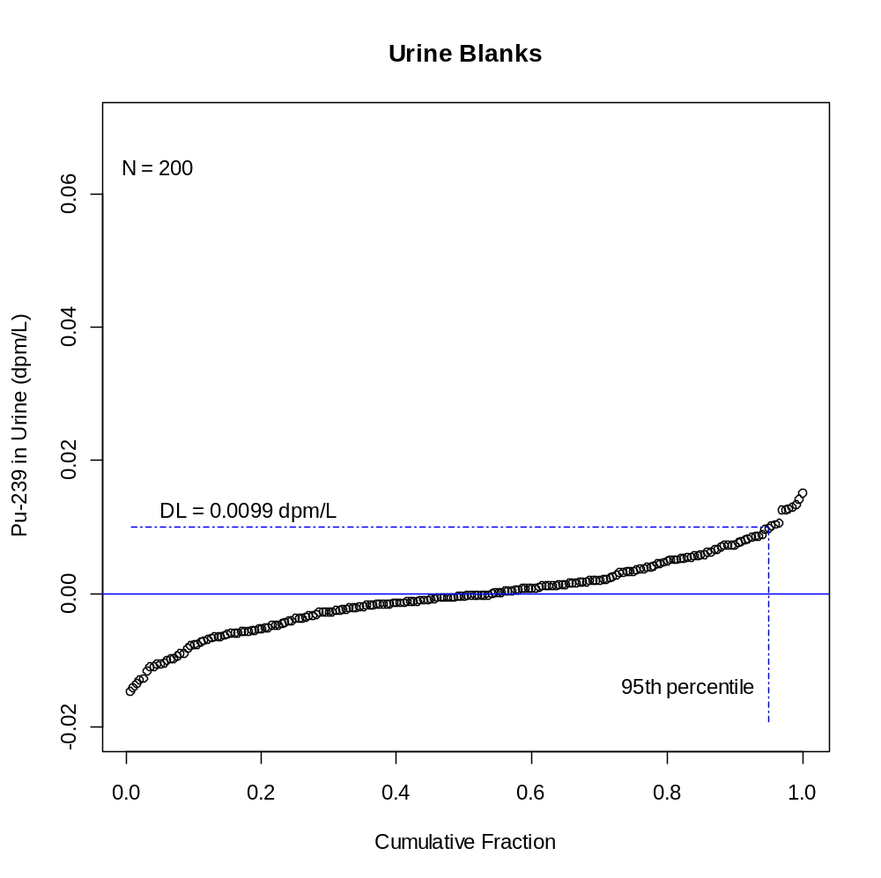
False Positives

Slide 89
Type I Error
  You conclude that there is analyte present when in fact there is none
  False Positive
Conclusion
Analyte
No Analyte
Incorrect
false negative
Analyte
Correct
Reality
Incorrect
false positive
No Analyte
Correct

Slide 90
Minimum Detectable Amount
The DL tells us nothing about the risk of deciding that analyte is not present when indeed it is (a false negative)
The minimum detectable amount is the amount of analyte that would fall below the DL β% (usually β = 5%) of the time (false negative)
  Used for design of bioassay programs and to describe the detection capabilities of a type of bioassay
  Should not be used to determine significance of any particular result

Slide 91
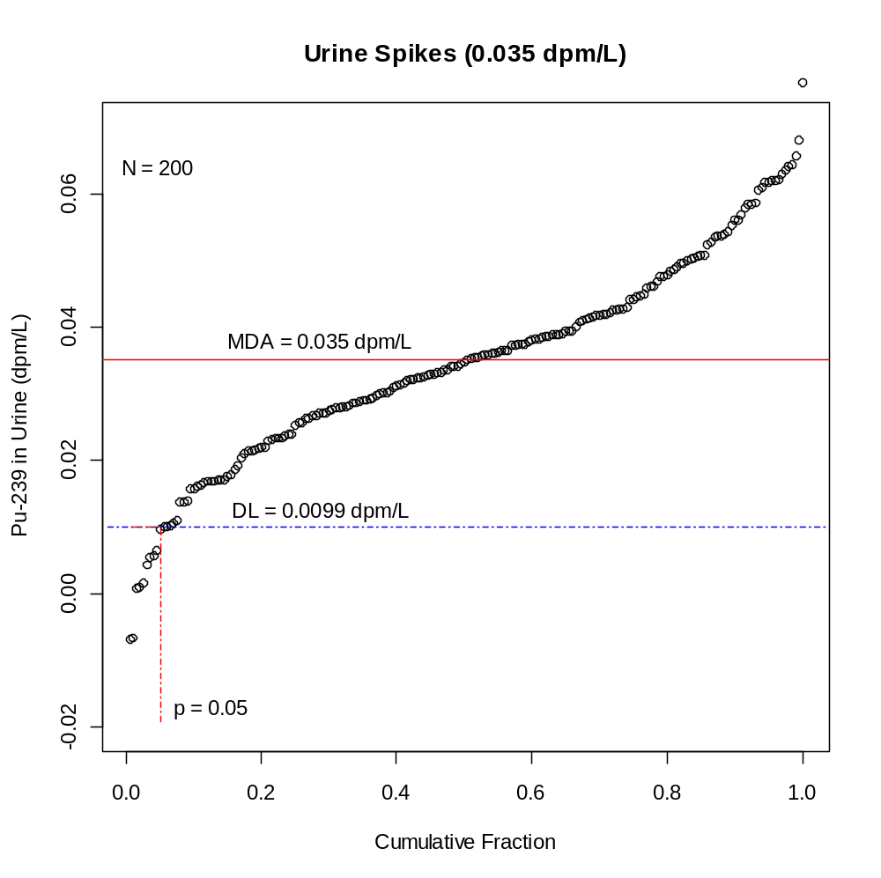
False Negatives

Slide 92
Type II Error
  You conclude that there is no analyte present when in fact there is
  False negative
Conclusion
Analyte
No Analyte
Incorrect
false negative
Analyte
Correct
Reality
Incorrect
false positive
No Analyte
Correct

Slide 93
In Practice
The DL is used to decide if a sample contains analyte
  we can’t tell a false positive from a true positive
The MDA is used to characterize the ability of an analytical method to detect analyte in the sample
  the MDA is not used to decide if a sample contains analyte

Slide 94
This was one realization of the DL and MDA, and if you run this experiment again you are likely to get a different DL and MDA
If you do this experiment many times, the mean DL and mean MDA will be good estimates of the long-run DL and MDA
  this is usually not feasible to do
A menagerie of DL and MDA formulas have been developed in an attempt to calculate the mean DL and mean MDA without incurring the trouble and expense of running all the blank and spike analyses
At least be aware of how your bioassay lab is calculating the DL and MDA

Slide 95
Type III Error - You came to right conclusion for the wrong reason, for example
  You correctly conclude that there is no analyte present, but it is the wrong analyte
  You correctly conclude that there is analyte present, but it did not come from the person
Conclusion
Analyte
No Analyte
Incorrect
false negative
Analyte
Correct
Reality
Incorrect
false positive
No Analyte
Correct

Slide 96
Last Word on DL/MDA
While there are many recommendations on how to calculate DL and MDA, there is no requirement that you do it a certain way.

Slide 97
Reference levels
Bioassay Program Design

Slide 98
Dose Coefficient (Conversion Factor)
Gives 50-year committed dose to organ or tissue from a unit intake of radioactive material
  For example, the Sv to bone surfaces from a
  1 Bq inhalation intake of Type S Pu-239
Includes dose from daughters that grow in after the intake

Slide 99
Intake Retention Fraction
m(t) – fraction of the intake that is present in a bioassay compartment at t days after the acute intake I
  the intake retention fraction (IRF)
M(t) – the quantity of activity estimated to be present in the same bioassay compartment at t days after the acute intake I
  the bioassay measurement

Slide 100
Reference Levels
“Values of measured quantities above which some specified action or decision should be taken. They include:
  “recording levels, above which a result should be recorded, lower values being ignored;
  “investigation levels, above which the cause or the implication of the result should be examined;
  “action levels, above which some remedial action should be considered.”
Notes:
Direct quote from ICRP Pub 78. While it discusses recording a “result”, in practice, all results will be recorded. We are really talking about doing something, i.e., calculating a dose from the result.
Recording level – record the dose and don’t worry about it
Investigation level – figure out the circumstances of the intake
Action level – consider medical intervention or some other action

Slide 101
Calculating Reference Levels
reference level equation
inhalation class F ⁶³Ni, urine sampling,
10 mrem recording level
Notes:
Corresponds to 6.48 Bq/l or 175 pCi/l
Below this value, just record the measurement.

Slide 102
Screening Level
The level of intake below which a bioassay result need not be considered for investigation of intake and assignment of dose. [0.002 SALI]
Notes:
Need to explain “SALI” here.
Revised 835 makes this 10 mrem for DOE – this is 1 mrem here.

Slide 103
Verification Level
The level of unexpected intake at or above which an attempt to confirm the intake as real should be made. [0.02 SALI]

Slide 104
Investigation Level
The level of intake at or above which a bioassay or air monitoring results shall be investigated for purposes of confirming intake and assessing dose. [0.1 SALI]

Slide 105
Medical Referral Level
The level of intake at or above which the medical staff shall be notified. [1 SALI]

Slide 106
Reference Levels for Class S Uranium
Level | f SALI | Intake | 24-h Urine | 24-Feces
Screening | 0.002 | 474 pCi | 1.56 fCi | 56.1 fCi
Verification | 0.02 | 4.74 nCi | 15.6 fCi | 561 fCi
Investigation | 0.1 | 23.7 nCi | 77.8 fCi | 2.81 pCi
Medical | 1 | 237 nCi | 778 fCi | 28.1 pCi
Notes:
MDA 0.01 pCi alpha spec

Slide 107
Intake and Dose Assessment
General Principles

Slide 108
What Are We Protecting the Worker From?
Deterministic Effects
Stochastic Effects

Slide 109
Deterministic Effect
Effect is on individual – not statistical
No effect until threshold dose is reached
Effect worsens with dose

Slide 110
Stochastic Effect
Effect is statistical and on population
Number of individuals with effect increases with dose to population.
Dreaded “linear non-threshold”

Slide 111
What is committed dose?
Notes:
Summed over all sources

Slide 112
Why committed dose?
Worker Protection
  Pu-239: 5 rem annual = 250 rem committed.
Worker’s Professional Livelihood
  Pu-239: 5 rem this year = 5 rem next year

Slide 113
What is effective dose?

Slide 114
Tissue Weighting Factors (ICRP-60)
Organ/Tissue | w_{T} | Organ/Tissue | w_{T}
Gonads | 0.20 | Liver | 0.05
Bone marrow (red) | 0.12 | Oesophagus | 0.05
Colon | 0.12 | Thyroid | 0.05
Lung | 0.12 | Skin | 0.01
Stomach | 0.12 | Bone surface | 0.01
Bladder | 0.05 | Remainder** | 0.05
Breast | 0.05

Slide 115
Remainder Organs (Modified ICRP-60)
Organ/Tissue | Mass (g) | Organ/Tissue | Mass (g)
Muscle | 28000 | Spleen | 180
Brain | 14000 | Thymus | 20
Small Intestine | 640 | Uterus | 80
Kidneys | 310 | Adrenals | 14
Pancreas | 100 | Extrathoracic airways | 15

Slide 116
Tissue Weighting Factors (ICRP-103)
Organ/Tissue | w_{T} | Organ/Tissue | w_{T}
Gonads | 0.08 | Liver | 0.04
Bone marrow (red) | 0.12 | Oesophagus | 0.04
Colon | 0.12 | Thyroid | 0.04
Lung | 0.12 | Skin | 0.01
Stomach | 0.12 | Bone surface | 0.01
Bladder | 0.04 | Remainder** | 0.05
Breast | 0.12 | Brain | 0.01
Salivary Glands | 0.01

Slide 117
Remainder Organs (ICRP-103)
Organ/Tissue | Organ/Tissue
Adipose Tissue | Adrenals
Connective Tissue | Extrathoracic Airways
Gall Bladder | Heart Wall
Kidney | Lymphatic Nodes
Muscle | Pancreas
Prostate | Small Intestine Wall
Thymus | Uterus/Cervix

Slide 118
Indicators of Intake
Positive nasal smear or contamination inside a respirator mask.
A worker is exposed to airborne radioactivity in excess of 8 DAC-h in a day or the indicated air concentration could greatly underestimate that to which the worker was exposed. The values for air concentration and exposure assume the protection factor for any respiratory protection in use will be applied.

Slide 119
Indicators of Intake
Contamination is measured on a single-layer protective clothing in excess of 10,000 d/m per 100 cm² alpha or 100,000 d/m per 100 cm² beta-gamma if respiratory protection is not in use.
Contamination is measured on the inner layer of multiple-layer protective clothing in excess of 10,000 d/m per 100 cm² alpha or 100,000 d/m per 100 cm² beta-gamma if respiratory protection is not in use.

Slide 120
Indicators of Intake
An unplanned release of radioactive material produces contamination on accessible surfaces in excesses of 1500 d/m per 100 cm² alpha or 15,000 d/m per 100 cm² beta-gamma if respiratory protection is not in use.
Any detectable personal contamination is measured on the hair, face, neck, chest, arms, or hands, or anywhere else on the body in excess of 1000 d/m per 100 cm² alpha or 10,000 d/m per 100 cm² beta-gamma if respiratory protection is not in use.

Slide 121
Bioassay as Indicator
A bioassay result value greater than the detection level may mean:
  The individual is carrying activity from a legacy intake.
  The individual had an intake from non-work-related activities (eating deer meat, drinking water…).
  The individual “crapped up” his sample.
  You are at the pointy end of the Gaussian curve.
Or… that he actually had an intake!!!

Slide 122
Workplace Monitoring and Control
If your workplace monitoring and control processes are effective, you should already know that this individual probably has had an intake and have made changes to that person’s bioassay protocol accordingly.

Slide 123
Confirmed Intake
So when is it officially an intake?
  One strike rule
  Two strike rule
  Bayesian criteria
You are responsible for developing and implementing the technical basis used to confirm an intake.

Slide 124
Minimum Detectable Dose (MDD)
MDD is used to gauge the ability of a given bioassay program to detect an intake of a specific radioactive material
  Used as an aid in the design of bioassay programs
  Is not used to assign a dose that may have occurred but was undetected
A dose that may have occurred but was undetected and is assigned nevertheless is referred to as a missed dose
MDD can help qualify a “negative” bioassay result.

Slide 125
MDD Calculation

Slide 126
MDD vs Investigation Level
The MDD is much less than the IL
  this is good
The MDD is more than the IL but below the regulatory limit
  this is not as good, but still OK
  might require compensatory actions
The MDD is above the regulatory limit
  this is a problem

Slide 127
Conclusions About Programs
The routine bioassay program for typical high-energy gamma emitting radionuclides can be used by itself to detect doses at the monitoring level
  This is clearly where you want to be
The routine bioassay program for some actinides (type S Pu-239) cannot by itself be used to detect doses at the monitoring level and, even worse, cannot by itself be used to demonstrate compliance with the annual dose limit of 0.05 Sv
  Take “Defense in Depth” approach
  Use alternate bioassay methods to lower the MDD

Slide 128
Defense in Depth
Keep workers and radioactive materials apart
Have systems in place to tell you when they inadvertently get together
Invoke special bioassay programs to detect and assess the intake and dose

Slide 129
To lower the MDD we must
Lower the MDA
  Mass spectrometry
  Fission Track
Increase the IRF
  Fecal sampling
  PAS
  Shorten the time between the intake and the collection of the sample

Slide 130
Last Word on Missed Dose
Uranium background – 0.1 μg/l
Additional intake of depleted uranium
What would you do for natural?
Class | 2-day MDD | 180-day MDD
F | 1.5 mrem | 75 mrem
M | 2.4 mrem | 200 mrem
S | 23 mrem | 200 mrem

Slide 131
Personal Air Sampling
Intake and Dose Assessment

Slide 132
Calculation of internal dose
Three parameters required:
  Measurement
  Dose coefficient (dose conversion factor)
  Intake retention fraction

Slide 133
Intake retention fraction
Fraction of intake expected to be present in the “compartment of interest” at the time of measurement.
The “compartment of interest” can be:
  Whole-body or fraction (organ/tissue)
  Excreta (urine or feces)
  Air sample!

Slide 134
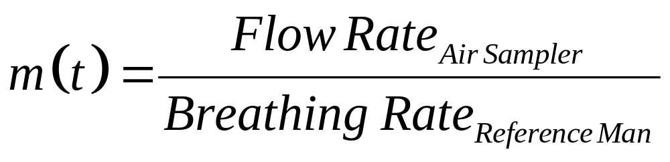
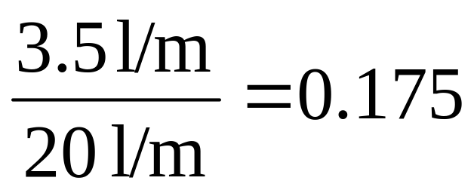
IRF for air sampler

Slide 135
IRF comparisons
Nuclide | Class | Period (d) | Type | IRF
³H | Vapor | 14 | Urine (conc) | 9.52 x 10⁻³
²³⁸U | M | 180 | Urine (24hr) | 6.42 x 10⁻⁵
²³⁹Pu | S | 180 | Urine (24hr) | 1.60 x 10⁻⁷
²⁴¹Am | M | 180 | Urine (24hr) | 1.10 x 10⁻⁵
⁹⁰Sr | F | 180 | Urine (24hr) | 4.64 x 10⁻⁵
¹³⁷Cs | F | 365 | Whole Body | 4.62 x 10⁻²
Any | Any | Real Time | PAS | 0.175

Slide 136
Dose calculation

Slide 137
Missed dose comparison
Nuclide | Class | Period (d) | Type | MDA | MDD (mrem)
³H | Vapor | 14 | Urine (conc) | 1000 pCi/l | 0.007
²³⁸U | M | 180 | Urine (24hr) | 0.1 μg/l | 4
²³⁹Pu | S | 180 | Urine (24hr) | 0.05 pCi/l | 100,000
²⁴¹Am | M | 180 | Urine (24hr) | 0.05 pCi/l | 600
⁹⁰Sr | F | 180 | Urine (24hr) | 5 pCi/l | 20
¹³⁷Cs | F | 365 | Whole Body | 8.9 nCi | 5

Slide 138
Minimum Detectable Dose for PAS*
Nuclide | Class | Emission | MDD (mrem)
²³⁸U | M | alpha | 0.02
²³⁹Pu | S | alpha | 1
²⁴¹Am | M | alpha | 0.3
⁹⁰Sr | F | beta | 0.001
¹³⁷Cs | F | beta | 0.0003
*Gross alpha/beta counting, MDAs = 5 x 10⁻⁷ μCi alpha, 2 x 10⁻⁶ μCi beta, m(t) = 0.175.

Slide 139
Can we assign the dose?
(b) The estimation of internal dose shall be based on bioassay data rather than air concentration values unless bioassay data are:
  (1) Unavailable;
  (2) Inadequate; or
  (3) Internal dose estimates based on air concentration values are demonstrated to be as or more accurate. [10CFR835.209]

Slide 140
Can we assign the dose?
(a) For purposes of assessing dose used to determine compliance with occupational dose equivalent limits, the licensee shall, when required under §20.1502, take suitable and timely measurements of—
  (1) Concentrations of radioactive materials in air in work areas; or
  (2) Quantities of radionuclides in the body; or
  (3) Quantities of radionuclides excreted from the body; or
  (4) Combinations of these measurements. [10CFR20.1204]

Slide 141
Summary
Requirements and Recommendations
  Recommendation organizations include ICRP, NCRP, and HPS (ANSI).
  There are a lot of recommendations, so you need to pick and choose what makes sense for your program.
  In the US, the DOE and NRC set the regulations.
  Both DOE and NRC provide guidance (although NRC has more).

Slide 142
Summary
Program Elements
  Radiation protection program infrastructure is an important part of the internal dosimetry program.
  There are requirements for when programs must exist.
  HPS ANSI N13.39 is a good place to start.

Slide 143
Summary
Bioassay monitoring programs
  Program types include:
    Routine
    Confirmatory
    Special
    Operational
  Baseline samples should be considered.
  Termination sampling may be required.

Slide 144
Summary
Who should be monitored?
  This isn’t necessarily an easy question to answer.
  Workplace indications are an important part of this decision.
  You probably don’t want to over-monitor.
  Don’t forget the dreaded “likelihood”.

Slide 145
Summary
MDA vs. DL
  MDA tells you about your analysis capability.
  DL tells you about a specific sample.
  Make sure you know the difference.
  You can calculate them any way you want.

Slide 146
Summary
Reference Levels
  Clear recommendations are found in HPS ANSI N13.39.
  They provide indicators of what to do next once you’ve decided a sample contains activity.
  They may include:
    Screening
    Verification
    Investigation
    Medical referral

Slide 147
Summary
Intake and dose assessment
  We are protecting the worker from deterministic and stochastic effects.
  Committed and effective concepts both make some sense from an operational perspective.
  Workplace indicators of intake are helpful and probably necessary.
  Know your missed dose (minimum detectable dose).

Slide 148
Summary
Personal air sampling
  Personal air sampling can be useful, especially where bioassay won’t do the job.
  Intake is easy to calculate.
  You don’t need a minimum sample volume since you’re not calculating airborne concentration.
  It’s allowed by NRC and under certain circumstances by DOE.

Slide 149
The Last (and First) Word
The only way internal dosimetry actually helps anybody, is by detecting workplace control failures that were otherwise undetected.
Being able to get a good estimate of dose may play an important role in medical treatment of severely overexposed individuals.
Scorekeeping is required.

